Slide 1

Steve Bishop Sr. Software Architect Gartman Technical Services
Consultant in IT and Software Development 15+ years
SQL Server DBA
.NET Full Stack Developer
Emphasis on ASP.NET MVC/WebAPI
Agile Coach
Website: ProgrammingMadeEZ.com
Work: GartmanTechnical.com
Facebook: Facebook.com/ProgrammingMadeEZ
Blog: Tech-Tid-Bits.Blogspot.com
Twitter: @Xipooo

Slide 2

The Titanic

Slide 3


Wireless Radio Operators
Jack Phillips
Sr. Wireless Operator RMS Titanic
Harold Bride
Jr. Wireless Operator RMS Titanic

Slide 4



Percy

Slide 5
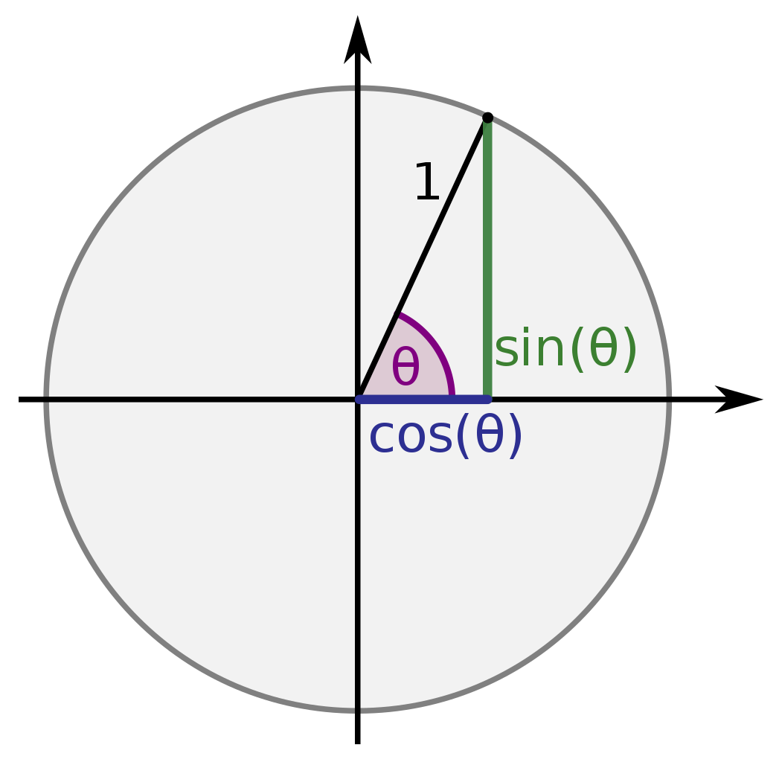


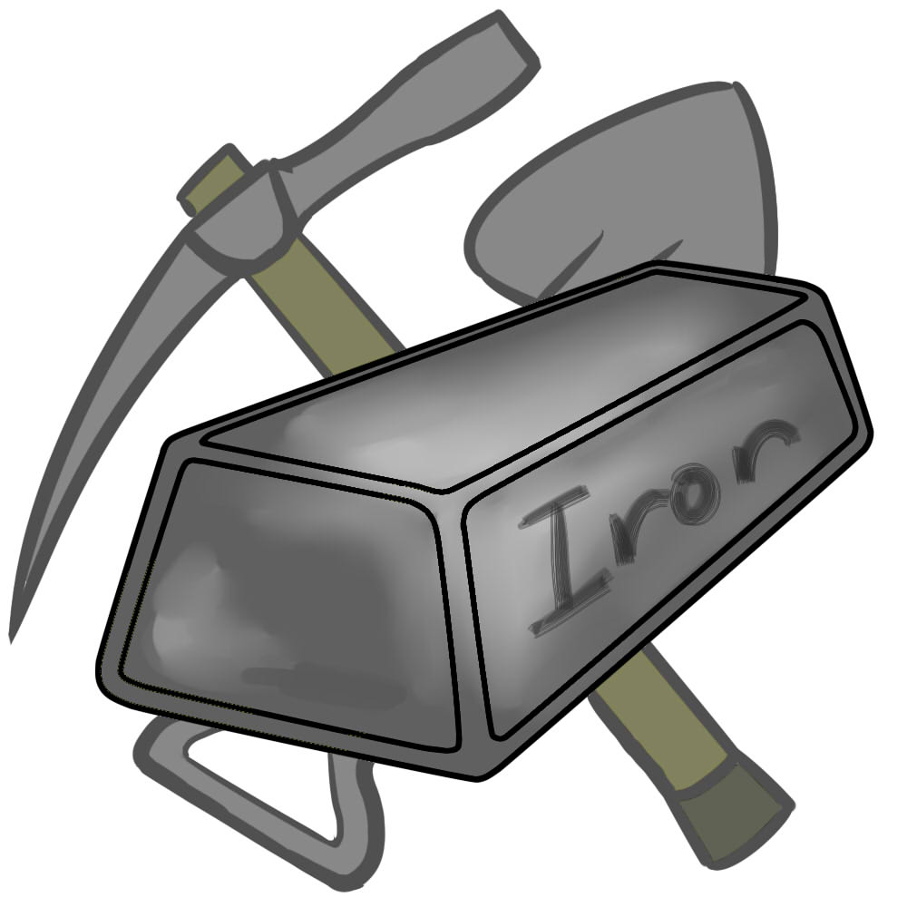

While on Watch
Self Taught
Trigonometry
Calculus
Chemistry
Physics
Metallurgy

Slide 6

Raytheon Company
1925: Lawrence Marshall & Vannevar Bush Hire Percy
(American Appliance Company)
Chief of Power Tube Division
1939: Win contract for building radar equipment – 2nd Highest Priority of the US Military
WWII Looms

Slide 7
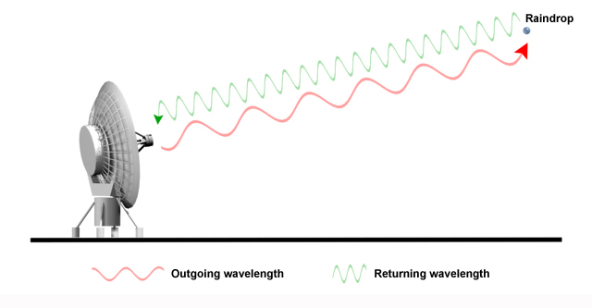
Radar

Slide 8
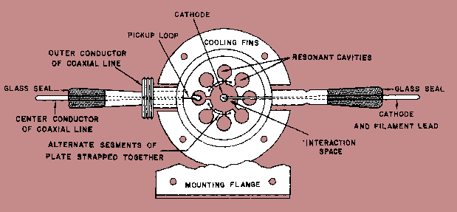
Magnetrons

Slide 9





The Infamous Candy Peanut Bar
Time for a snack.
What the heck?

Slide 10
ASP.NET Core
One Platform To Rue Them All

Slide 11
Things You Will Need
.NET Core 1.1+
https://www.microsoft.com/net/download/core
Nodejs 6.10+/7.10+
https://nodejs.org/en/
Visual Studio Code or Visual Studio 2015-2017
https://code.visualstudio.com/
https://www.visualstudio.com/
C# Extension (VS Code)
CLI Commands (VS Code)
https://docs.microsoft.com/en-us/dotnet/articles/core/tools/

Slide 12

Architecture
C#/F#
Nuget Packages (MetaPackages)
Roslyn Compiler
Us
CIL (Common Intermediate Language)
CoreCLR (Common Language Runtime)
RyuJIT Compiler (C++)
Native Code
Native Code
Native Code
Native Code
Windows
Linux
MacOS
FreeBSD

Slide 13
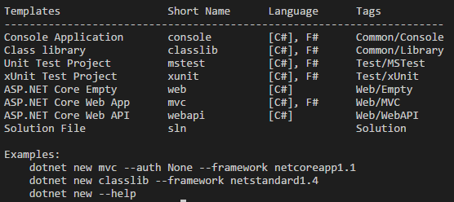
Dotnet new --help

Slide 14

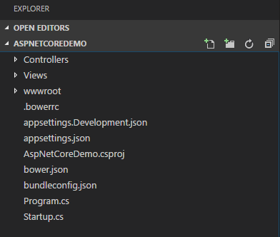
Dotnet new mvc

Slide 15
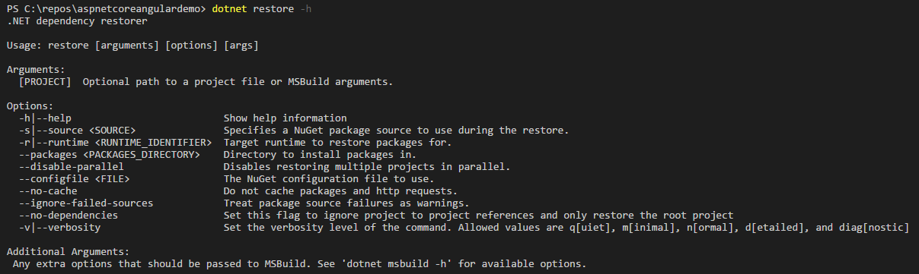
Dotnet restore --help

Slide 16
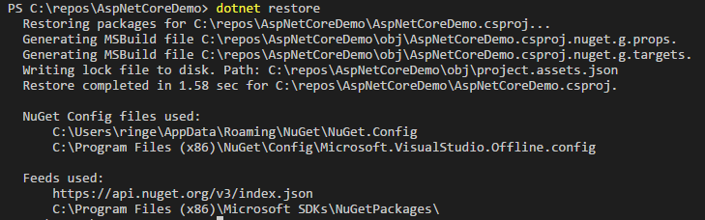
Dotnet restore

Slide 17
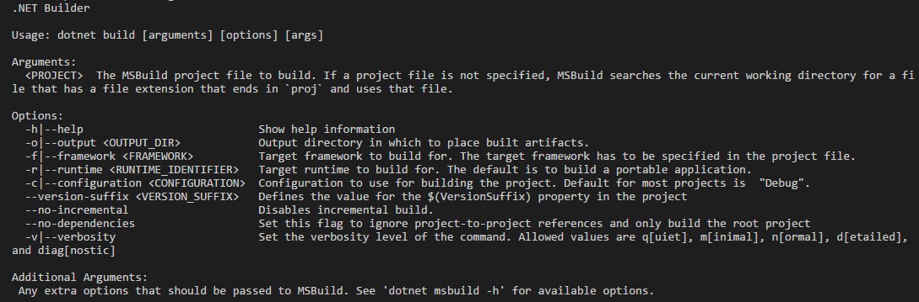
Dotnet build --help

Slide 18
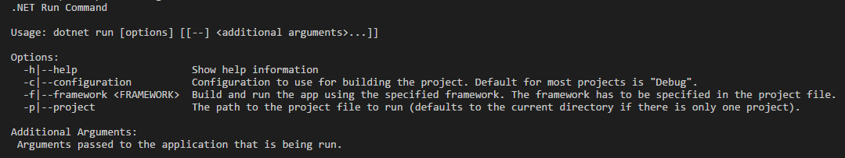
Dotnet run --help

Slide 19

Dotnet run
Navigate to http://localhost:5000

Slide 20
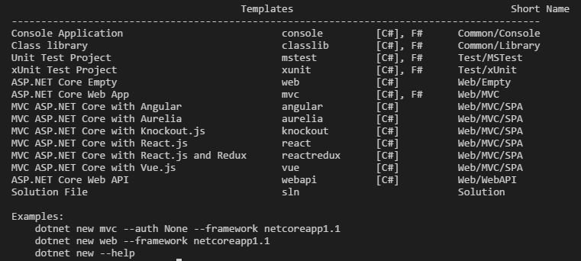
Dotnet new --install Microsoft.AspNetCore.SpaTemplates::*

Slide 21

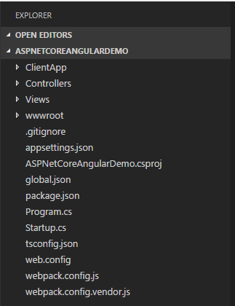
Dotnet new angular

Slide 22
But I Was Told To Node All The Things!
Yo…
Man.
Chill
npm install -g yo
http://yeoman.io/generators/
Npm install –g generator-aspnetcore-spa
yo aspnetcore-spa
Follow instructions like a good user

Slide 23
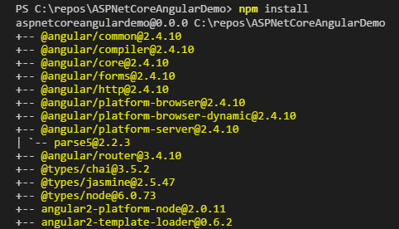
Npm install

Slide 24
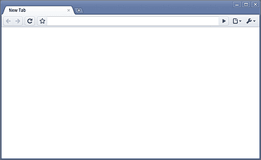
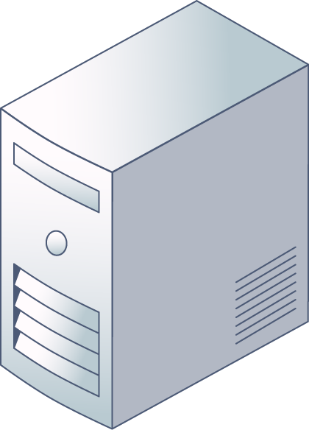

Middleware Pipeline
Context
-Request
-Response
ASP.NET Core
Request
Response
Middleware

Slide 25
Program.cs & Startup.cs
ConfigureServices()
Add Middleware To Pipeline
Register Dependency Injection Classes
Configure()
Environment Dependent Configuration
Configure Static Files
Configure Routing

Slide 26
Request Routing
URL: http://localhost:52577/Home/Index
{Protocol}
{Host}
{Controller}
{Action}
Network &
Server
MVC
Routing Template: {controller}/{action}
Routing Template: {controller=Home}/{action=Index}
Routing Template: {controller=Home}/{action=Index}/{id?}

Slide 27
MVC: Model, View, Controller
Request
Controller
Orchestrator
(View Model)
Model
Data Structure
(DB, EF, Service, Repository)
View
User Interface
(Razor, HTML, Javascript, WPF, Forms)
Response

Slide 28
Environment Variable
PowerShell: $Env:ASPNETCORE_ENVIRONMENT = “Development”
CMD: setx ASPNETCORE_ENVIRONMENT = “Development”
MAC/Linux: export ASPNETCORE_ENVIRONMENT=Development

Slide 29
Dotnet Watcher
https://github.com/aspnet/DotNetTools
Add To csproj:
<ItemGroup>
<DotNetCliToolReference Include="Microsoft.DotNet.Watcher.Tools" Version="1.0.0" />
</ItemGroup>
DotNet watch run

Slide 30
Webpack Middleware
Startup.Configure()
Add: app.UseWebpackDevMiddleware()
Hotswap Module
Add Parameter: new WebpackDevMiddlewareOptions { HotModuleReplacement = true }
React HotModule Replacement
Add Parmeter: new WebpackDevMiddlewareOptions {
HotModuleReplacement = true,
ReactHotModuleReplacement = true }

Slide 31
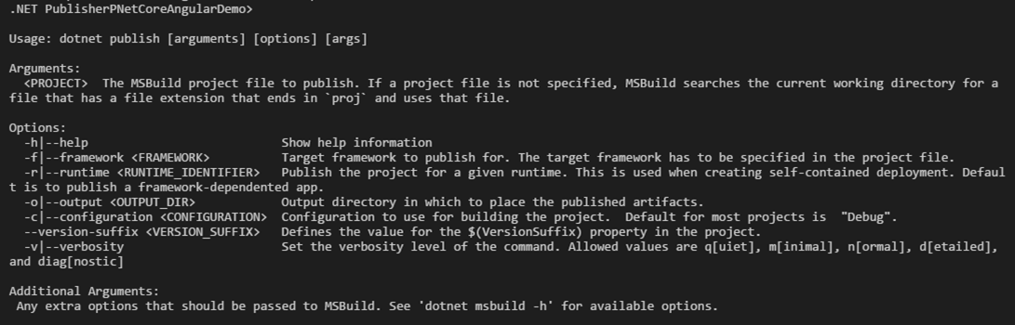
Dotnet publish --help

Slide 32
Dotnet publish
Self-Contained Deployment (SCD)
App and Dependencies including .NET Core is Packaged
Add PropertyGroup/RuntimeIdentifier Tag with RID Value in csproj
Use –-runtime RID
RIDS: https://docs.microsoft.com/en-us/dotnet/articles/core/rid-catalog
Framework-Dependent Deployment (FDD)
.NET Core Must be Pre-Installed on OS
Skip –-runtime Argument

Slide 33
Dotnet publish –-configuration Release
Framework-Dependent Deployment
Files are published to \bin\Release\<FrameworkVersion>\Publish

Slide 34

Dotnet <application.dll>
Open Listening URL

Slide 35
Additional Resources
https://github.com/dotnet/core
Core Github Repo
https://docs.microsoft.com/en-us/aspnet/core/publishing/
Hosting and Deployment Instructions
https://github.com/dotnet/coreclr/blob/master/Documentation/botr/README.md
The Book Of The Runtime (Everything you ever wanted to know about the CLR)
https://github.com/aspnet/JavaScriptServices
Javascript Client Side and Server Side Middleware (run Nodejs packages!)

Slide 36
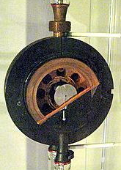
The Infamous Candy Peanut Bar
Well that’s interesting

Slide 37

Experiment
Microwave

Slide 38
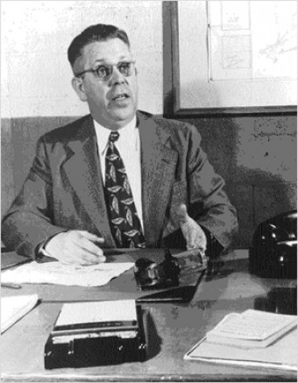
Percy Spencer
Inventor of The
Microwave

